Slide 1
Listening Rooms as Development Tools Nichola Cadet, SHU, Senior Lecturer @nicholacadet Jessica Scott, 2nd year student researcher

Slide 2
Aims of the session
To introduce you to the concept of 'the listening room'
To outline the methodology and framework for analysis
To consider questions to be addressed
To identify barriers to participation

Slide 3
Activity Holiday memories
Place yourself in groups of 3
Number yourself 1-3
Number 1 come to the front of the room
Numbers 2-3 have a conversation about your favourite holiday memory

Slide 4
https://blogs.shu.ac.uk/achieve/listening-rooms/?doing_wp_cron=1549441496.4774560928344726562500

Slide 5
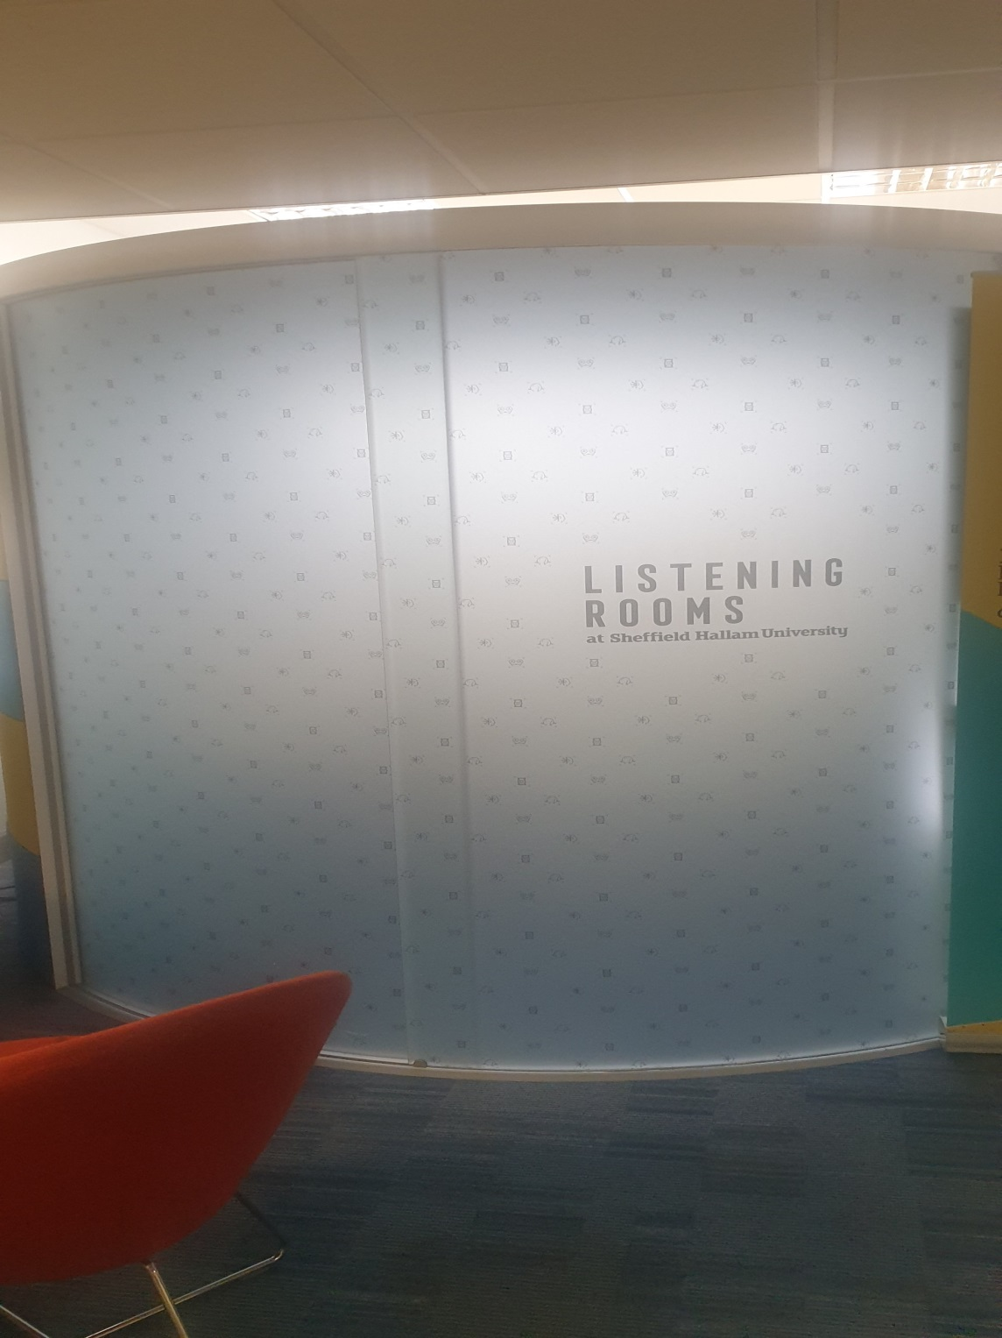

Slide 6
Method
‘meta’ level: - how conversations were conducted and how participants navigate their way through the cue cards and the topics.
University friends hold conversations with depth, maturity, humour and feeling and are also able to gently probe each other and keep on track.
the researcher is given a privileged insight into what really matters, and why; in effect, to understand what is important and what everyday experiences are like as a student.
Heron, E. (2019) Friendship as method: reflections on a new approach to understanding student experiences in higher education, Journal of Further and Higher Education, DOI: 10.1080/0309877X.2018.1541977

Slide 7
One pair of first-year engineers, for example, when discussing whether they ‘felt like engineers’, talk about what they felt to be impenetrable information from their course: ‘I’m still so clueless with everything they [tutors] talk about’ (Annie), which in turn led her friend, Jane, to comment:
And I wouldn’t say I belong to the course but I automatically feel like I belong to a wider group of engineers outside of uni, especially as a woman engineer.
Heron, E. (2019) Friendship as method: reflections on a new approach to understanding student experiences in higher education, Journal of Further and Higher Education, DOI: 10.1080/0309877X.2018.1541977

Slide 8
Notes:
Applicability to PASS?

Slide 12
Feedback from participants: Process
Best way to do it :)
Forgot we was being recorded at some point but i feel like interviews/surveys wouldn't have got that sort of information
Really good; didn't feel anxious and I was more honest
Informal
I liked having the prompts; made it easier to know what to talk about
Less pressure and no interviewer effect
Fun, reduces any stress
The casual vibe and ability to go off topic

Slide 13
Barriers and things to consider
Identifying participants
Not having listened to the interviews - emerging themes
Timescales for students
Space for the conversations and facilitating the interviews
Buy-in to analysis (round table)

