Slide 1





Using peer learning to increase attainment for underrepresented groups
Kingston University
Rebecca Maccabe
r.maccabe@kingston.ac.uk

Slide 2





Provider
Post-92
Diverse student population
16,500 students
4 campuses
TEF Bronze
Cost savings
NSS – London University
Notes:
Pictures with reflection and blurred background
(Basic)
To reproduce the picture effects on this slide, do the following:
On the Home tab, in the Slides group, click Layout, and then click Blank.
On the Insert tab, in the Images group, click Picture.
In the Insert Picture dialog box, select a picture and then click Insert.
Select the picture. Under Picture Tools, on the Format tab, in the Size group, click the arrow below Crop, point to Crop to Shape, and then under Rectangles click Round Diagonal Corner Rectangle.
Also under Picture Tools, on the Format tab, in the Size group, click the Size and Position dialog box launcher. In the Format Picture dialog box, resize or crop the image so that the height is set to 2” and the width is set to 2.4”. To crop the picture, click Crop in the left pane, and in the right pane, under Crop position, enter values into the Height, Width, Left, and Top boxes. To resize the picture, click Size in the left pane, and in the right pane, under Size and rotate, enter values into the Height and Width boxes.
Also in the Format Picture dialog box, click Reflection in the right pane, and in the Reflection pane, in the Presets list, click Half Reflection, Touching.
On the Insert tab, in the Images group, click Picture.
In the Insert Picture dialog box, select a different picture and then click Insert. Repeat this process until there are three pictures on the slide.
Select the second picture. Under Picture Tools, on the Format tab, in the Size group, click the Size and Position dialog box launcher. In the Format Picture dialog box, resize or crop the image so that the height is set to 2” and the width is set to 2.4”. To crop the picture, click Crop in the left pane, and in the right pane, under Crop position, enter values into the Height, Width, Left, and Top boxes. To resize the picture, click Size in the left pane, and in the right pane, under Size and rotate, enter values into the Height and Width boxes.
Select the third picture. Under Picture Tools, on the Format tab, in the Size group, click the Size and Position dialog box launcher. In the Format Picture dialog box, resize or crop the image so that the height is set to 2” and the width is set to 2.4”. To crop the picture, click Crop in the left pane, and in the right pane, under Crop position, enter values into the Height, Width, Left, and Top boxes. To resize the picture, click Size in the left pane, and in the right pane, under Size and rotate, enter values into the Height and Width boxes.
Select the first picture. On the Home tab, in the Clipboard group, click Format Painter. With the Format Painter cursor, on the slide, click the second picture.
Select the first picture. On the Home tab, in the Clipboard group, click Format Painter. With the Format Painter cursor, on the slide, click the third picture.
Press and hold CTRL, and then select all three pictures. On the Home tab, in the Drawing group, click Arrange, point to Align, and then do the following:
Click Align Selected Objects.
Click Align Middle.
To reproduce the background effects on this slide, do the following:
On the Insert tab, in the Images group, click Picture.
In the Insert Picture dialog box, select a picture and then click Insert.
Select the picture. Under Picture Tools, on the Format tab, in the Size group, click the Size and Position dialog box launcher. In the Format Picture dialog box, resize or crop the image so that the height is set to 7.5” and the width is set to 10”. To crop the picture, click Crop in the left pane, and in the right pane, under Crop position, enter values into the Height, Width, Left, and Top boxes. To resize the picture, click Size in the left pane, and in the right pane, under Size and rotate, enter values into the Height and Width boxes.
Also in the Format Picture dialog box, click Artistic Effects in the left pane, and in the Artistic Effects pane, do the following:
Click the button next to Presets and then click Blur (second row, fifth option from the left).
In the Radius box, enter 30.
On the Home tab, in the Drawing group, click Shapes, and under Rectangles click Rectangle (first option from the left).
Drag to draw a rectangle on the slide.
Select the rectangle. Under Drawing Tools, on the Format tab, in the Size group, enter 7.5” into the Height box and enter 10” into the Width box.
Also under Drawing Tools, on the Format tab, in the Shape Styles group, click Shape Fill, point to Gradients, and then click More Gradients. In the Format Shape dialog box, click Fill in the left pane, select Gradient fill in the Fill pane, and then do the following:
In the Type list, select Radial.
In the Direction list, select From Center.
Under Gradient stops, click Add gradient stops or Remove gradient stops until two stops appear in the slider.
Also under Gradient stops, customize the gradient stops as follows:
Select the first stop from the left in the slider, and then do the following:
In the Position box, enter 0%.
Click the button next to Color, and then under Theme Colors click White, Background 1 (first row, first option from the left).
In the Transparency box, enter 60%.
Select the second stop from the left in the slider, and then do the following:
In the Position box, enter 100%.
Click the button next to Color, and then under Theme Colors click White, Background 1 (first row, first option from the left).
In the Transparency box, enter 0%.
Also in the Format Shape dialog box, click Line Color in the right pane, and in the Line Color pane select No Line.
Select the shape. On the Home tab, in the Drawing group, click Arrange, point to Align, and then do the following:
Click Align to slide.
Click Align Middle.
Click Align Center.
On the Home tab, in the Drawing group, click Arrange, and then click Send to Back.
Select the background picture. On the Home tab, in the Drawing group, click Arrange, and then click Send to Back.

Slide 3


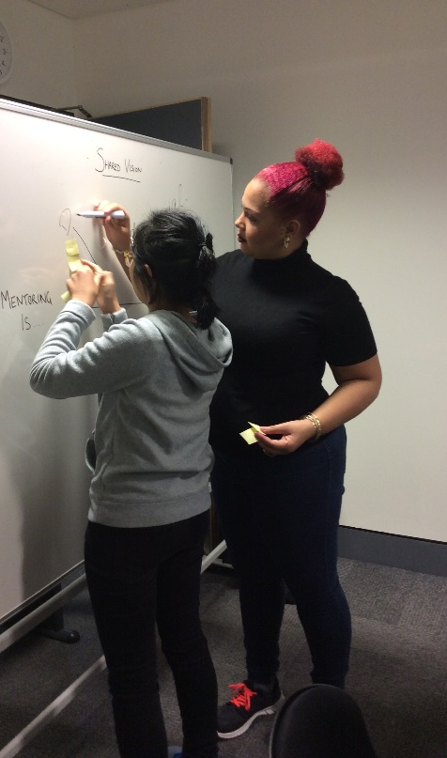
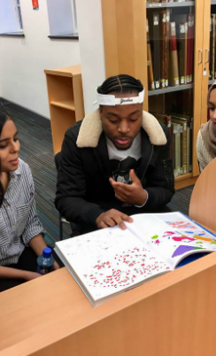

Participation
Significant gaps in progression and/or retention were identified for the following groups:
BME learners (51.6%)
Care leavers and learners estranged from their family (1.2% of new entrants)
Disabled learners and those with a SpLD (13.5%)
Students from disadvantaged backgrounds and/or with a low household income (63.2%)
Clearing entrants (28%)
Commuter students (54.6%)

Slide 4

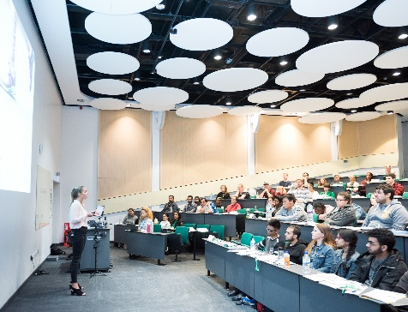
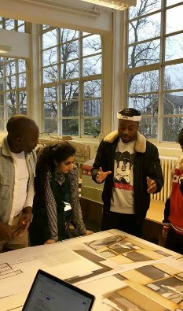
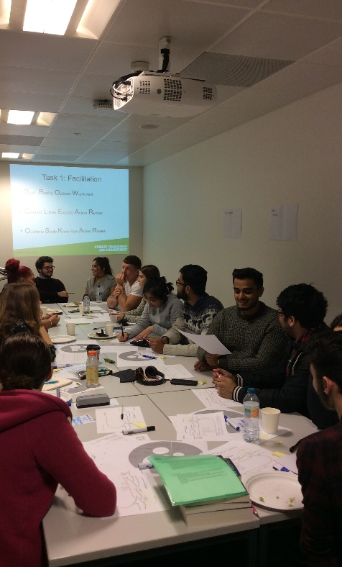

Programme
26 courses (L4 & L5)
Cross-level mentoring
4 styles of delivery
200 mentors
Over 1200 mentees
Access funded
Closely aligned to learning, teaching and assessment

Slide 5


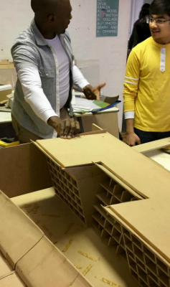
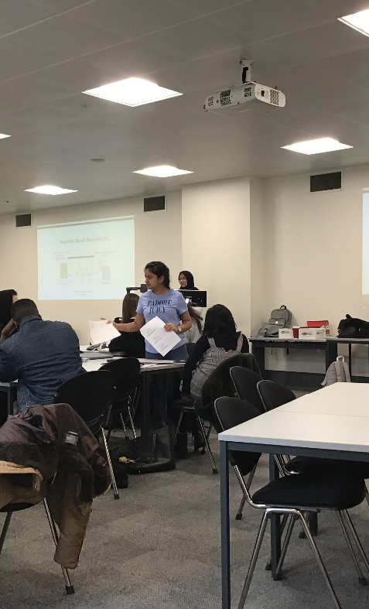
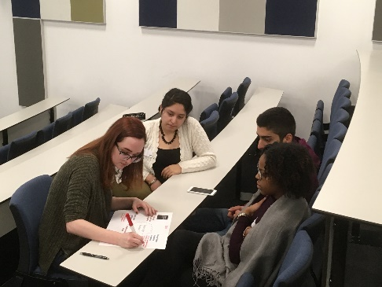
Performance
80%+ students who participated in the programme fell within the access funded student population
Mentors (15% higher progression rates)
Mentees (8% higher progression rates, despite lower tariff on entry)
Engagement in timetabled peer assisted study sessions can have a 20%+ increase on module pass rates
Commuting students who engaged as an academic mentee had 24% higher progression rates, despite a lower tariff on entry
BTEC students who engaged in the programme had 21% higher progression rates than their disengaged counterparts
98.7% of mentors enjoyed and felt supported in the role.

Slide 6
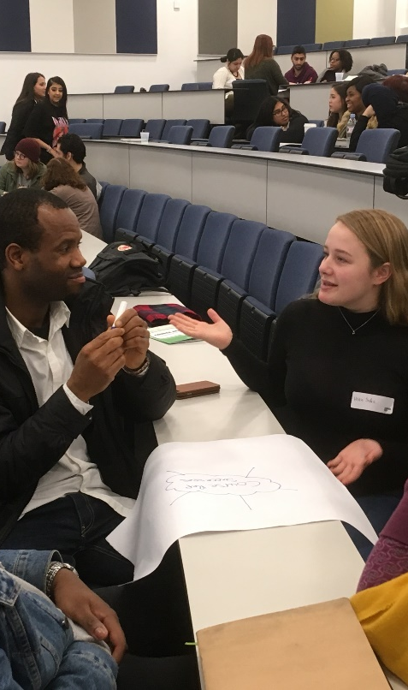




Plan
Programme growth (30 courses)
Targeting courses based on the greatest ‘need’
Accurate measure of programme reach
Impact reports (Planning Office)
Student engagement

